Slide 1
TOPIC :A SLEEP TRACKING FOR APP THE
BETTER NIGHT'S REST
TEAM MEMBERS :
AKILAN.G
ASFAQ AHAMED
DEVA ASIRVATHAM
MOHAMMED AJMAL

Slide 2
DESCRIPTION
▶ A good night’s sleep is essential for a healthy, productive, and energized life. Better Night’s Rest is the ultimate sleep tracking app, designed to help you understand and improve your sleep patterns for optimal well-being. Whether you’re looking to wake up feeling refreshed, address sleep challenges, or simply learn more about your habits, this app is your perfect companion.
▶ Transform Your Sleep with Cutting-Edge Features
▶ Advanced Sleep Monitoring:
▶ Track your sleep cycles, including light, deep, and REM stages, using the app’s smart technology. With seamless integration into wearable devices or your phone’s sensors, it provides accurate and detailed sleep data.
▶ Personalized Insights:
▶ Receive tailored recommendations based on your sleep patterns. The app analyzes trends, highlights areas for improvement, and offers actionable tips to enhance your sleep quality.
▶ Smart Alarms:
▶ Wake up at the optimal moment with the app’s smart alarm feature. By monitoring your sleep stages, it
ensures you rise during light sleep, reducing grogginess and helping you feel more alert.
▶ Relaxation Tools:
▶ Drift off faster with a curated library of guided meditations, calming sounds, and breathing exercises designed to prepare your mind and body for rest.

Slide 3
PROGRAM:
MainActivity.kt
package com.example.projectone
import android.content.Context import android.content.Intent
import android.icu.text.SimpleDateFormat import android.os.Bundle
import androidx.activity.ComponentActivity
import androidx.activity.compose.setContent import androidx.compose.foundation.Image import androidx.compose.foundation.layout.* import androidx.compose.material.Button
import androidx.compose.material.MaterialTheme import androidx.compose.material.Surface
import androidx.compose.material.Text import androidx.compose.runtime.* import androidx.compose.ui.Alignment import androidx.compose.ui.Modifier import androidx.compose.ui.draw.alpha
import androidx.compose.ui.layout.ContentScale

Slide 4
Import androidx.compose.ui.res.painterResource import androidx.compose.ui.unit.dp
import androidx.core.content.ContextCompat
import com.example.projectone.ui.theme.ProjectOneTheme import java.util.*
class MainActivity : ComponentActivity() {
private lateinit var databaseHelper: TimeLogDatabaseHelper override fun onCreate(savedInstanceState: Bundle?) {
super.onCreate(savedInstanceState) databaseHelper = TimeLogDatabaseHelper(this)
databaseHelper.deleteAllData() setContent {
ProjectOneTheme {
// A surface container using the ‘background’ color from
the theme
Surface(
modifier = Modifier.fillMaxSize(),
color = MaterialTheme.colors.background
) {

Slide 5
MyScreen(this,databaseHelper)
}
}
}
}
}
@Composable
fun MyScreen(context: Context, databaseHelper: TimeLogDatabaseHelper) {
var startTime by remember { mutableStateOf(0L) } var elapsedTime by remember {
mutableStateOf(0L) }
var isRunning by remember { mutableStateOf(false) }
val imageModifier = Modifier Image(

Slide 6
painterResource(id = R.drawable.sleeptracking), contentScale = ContentScale.FillHeight, contentDescription = “”,
modifier = imageModifier
.alpha(0.3F),
)
Column(
modifier = Modifier.fillMaxSize(), horizontalAlignment = Alignment.CenterHorizontally, verticalArrangement = Arrangement.Center
) {
if (!isRunning) { Button(onClick = {
startTime = System.currentTimeMillis()
isRunning = true

Slide 7
}) {
Text(“Start”)
//databaseHelper.addTimeLog(startTime)
}
} else {
Button(onClick = {
elapsedTime = System.currentTimeMillis() isRunning = false
}) {
Text(“Stop”)
databaseHelper.addTimeLog(elapsedTime,startTime)
}
}
Spacer(modifier = Modifier.height(16.dp))
Text(text = “Elapsed Time: ${formatTime(elapsedTime –
startTime)}”)
Spacer(modifier = Modifier.height(16.dp)) Button(onClick = { context.startActivity(
Intent(
context, TrackActivity::class.java
)

Slide 8
}) {
Text(text = “Track Sleep”)
}
}
}
private fun startTrackActivity(context: Context) {
val intent = Intent(context, TrackActivity::class.java) ContextCompat.startActivity(context, intent, null)
}
fun getCurrentDateTime(): String {
val dateFormat = SimpleDateFormat(“yyyy-MM-dd HH:mm:ss”, Locale.getDefault())
val currentTime = System.currentTimeMillis() return dateFormat.format(Date(currentTime))
}

Slide 9
LoginActivity.kt:
package com.example.projectone
import android.content.Context import android.content.Intent import android.os.Bundle
import androidx.activity.ComponentActivity
import androidx.activity.compose.setContent import androidx.compose.foundation.Image import androidx.compose.foundation.layout.* import androidx.compose.material.*
import androidx.compose.runtime.*
import androidx.compose.ui.Alignment import androidx.compose.ui.Modifier import androidx.compose.ui.draw.alpha import androidx.compose.ui.graphics.Color
import androidx.compose.ui.layout.ContentScale import androidx.compose.ui.res.painterResource

Slide 10
Import androidx.compose.ui.text.font.FontFamily import androidx.compose.ui.text.font.FontWeight import androidx.compose.ui.unit.dp
import androidx.compose.ui.unit.sp
import androidx.core.content.ContextCompat import
com.example.projectone.ui.theme.ProjectOneTheme
class LoginActivity : ComponentActivity() { private lateinit var databaseHelper:
UserDatabaseHelper
override fun onCreate(savedInstanceState: Bundle?)
{
super.onCreate(savedInstanceState) databaseHelper = UserDatabaseHelper(this) setContent {
ProjectOneTheme {
// A surface container using the
‘background’ color from the theme
Surface(
modifier = Modifier.fillMaxSize(),
color = MaterialTheme.colors.background
) {
LoginScreen(this, databaseHelper)

Slide 11
@Composable
fun LoginScreen(context: Context, databaseHelper: UserDatabaseHelper) {
var username by remember { mutableStateOf(“”) } var password by remember { mutableStateOf(“”) } var error by remember { mutableStateOf(“”) }
val imageModifier = Modifier Image(
painterResource(id = R.drawable.sleeptracking), contentScale = ContentScale.FillHeight, contentDescription = “”,
modifier = imageModifier
.alpha(0.3F),
)
Column(
modifier = Modifier.fillMaxSize(), horizontalAlignment = Alignment.CenterHorizontally, verticalArrangement = Arrangement.Center
) {

Slide 12
AndroidManifest.xml:
<?xml version=“1.0” encoding=“utf-8”?>
<manifest xmlns:android= http://schemas.android.com/apk/res/android
xmlns:tools="http://schemas.android.com/tools">
<application android:allowBackup="true"
android:dataExtractionRules="@xml/data_extraction_rule s"
android:fullBackupContent="@xml/backup_rules" android:icon="@mipmap/ic_launcher" android:label="@string/app_name" android:supportsRtl="true" android:theme="@style/Theme.ProjectOne" tools:targetApi="31">
<activity
android:name=".TrackActivity" android:exported="false"
android:label="@string/title_activity_track"
android:theme="@style/Theme.ProjectOne" />

Slide 13
<activity
android:name=“.MainActivity” android:exported=“false” android:label=“@string/app_name” android:theme=“@style/Theme.ProjectOne” />
<activity
android:name=“.MainActivity2” android:exported=“false” android:label=“RegisterActivity” android:theme=“@style/Theme.ProjectOne” />
<activity
android:name=“.LoginActivity” android:exported=“true” android:label=“@string/app_name” android:theme=“@style/Theme.ProjectOne”>
<intent-filter>
<action android:name=“android.intent.action.MAIN” />

Slide 14
Android:name=“android.intent.categor y.LAUNCHER” />
</intent-filter>
</activity>
</application>
</manifest>

Slide 15
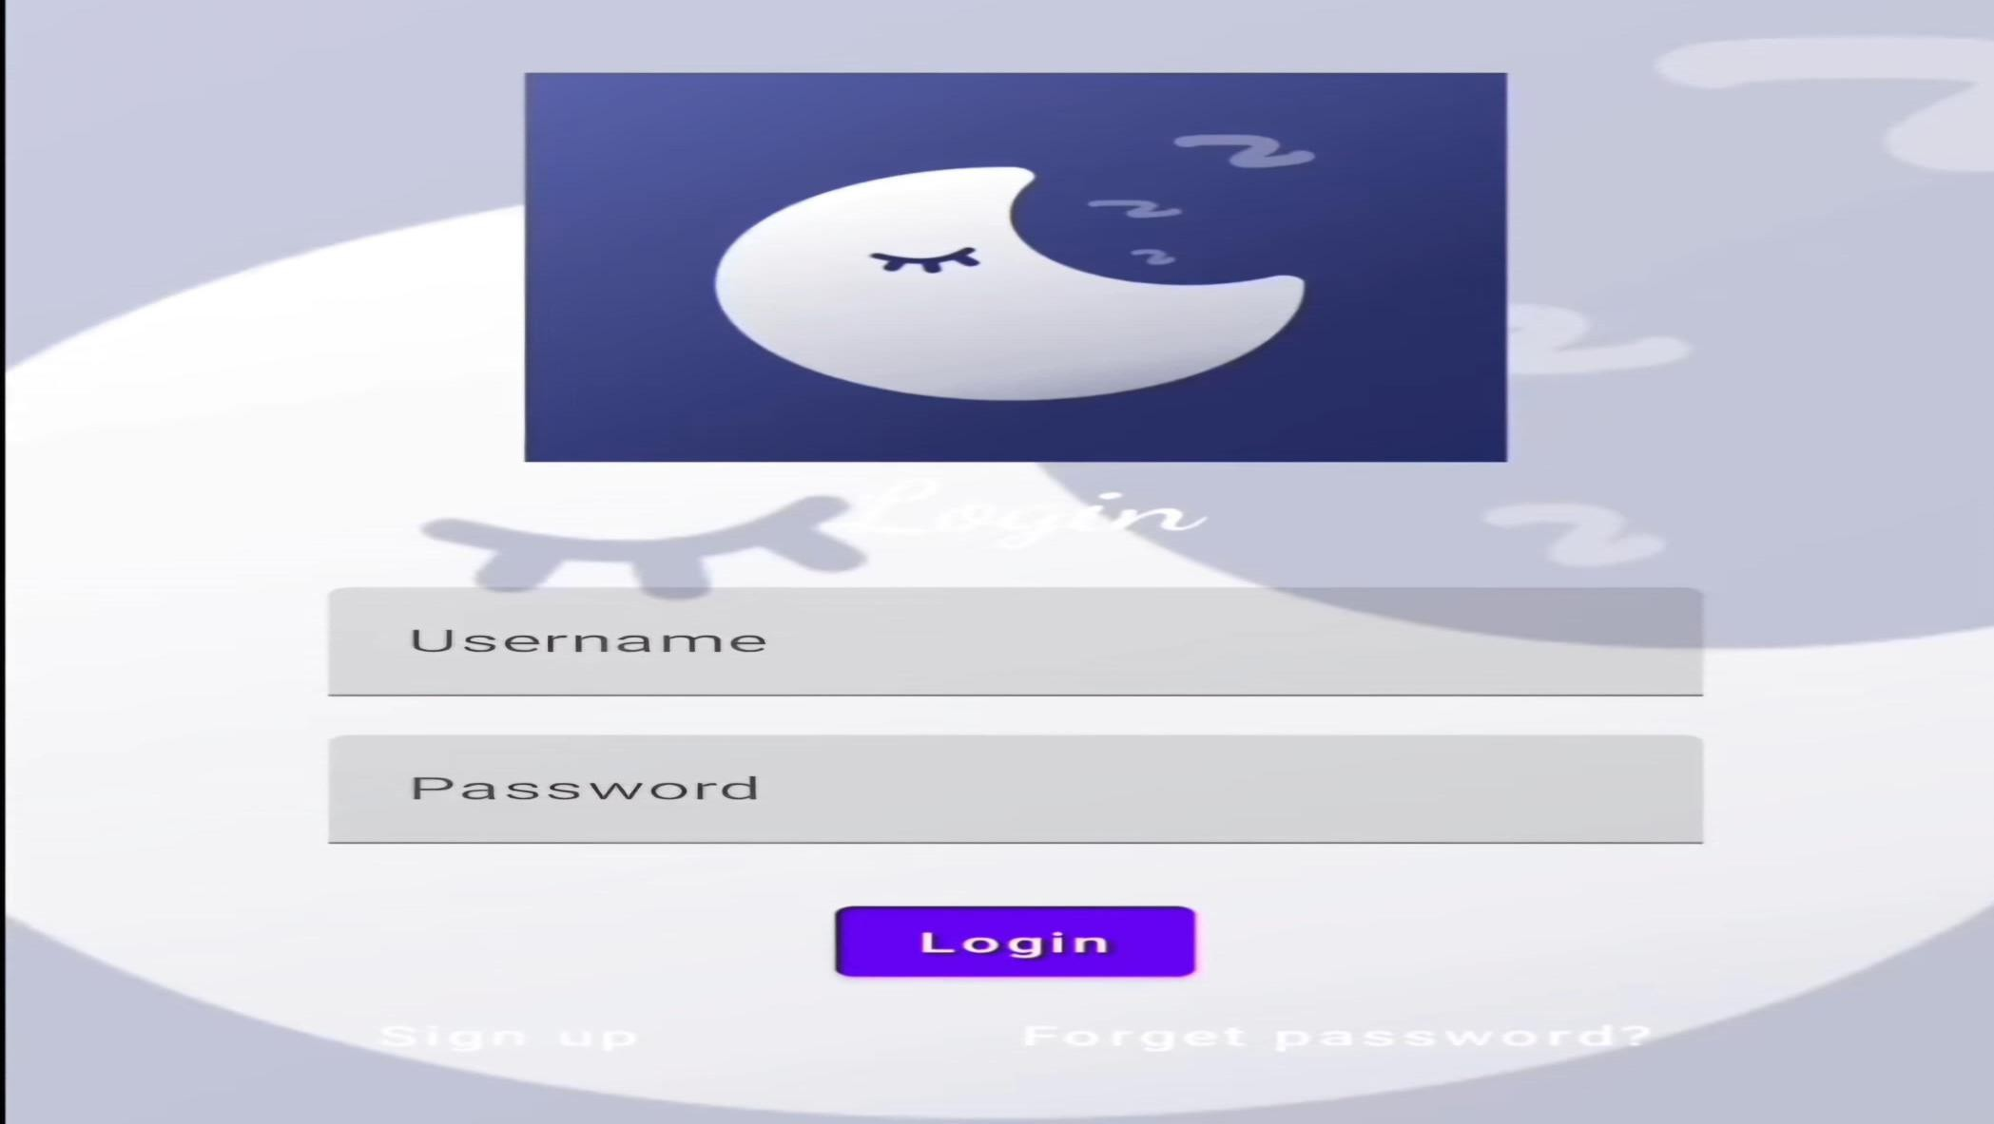
Outputs:

Slide 16
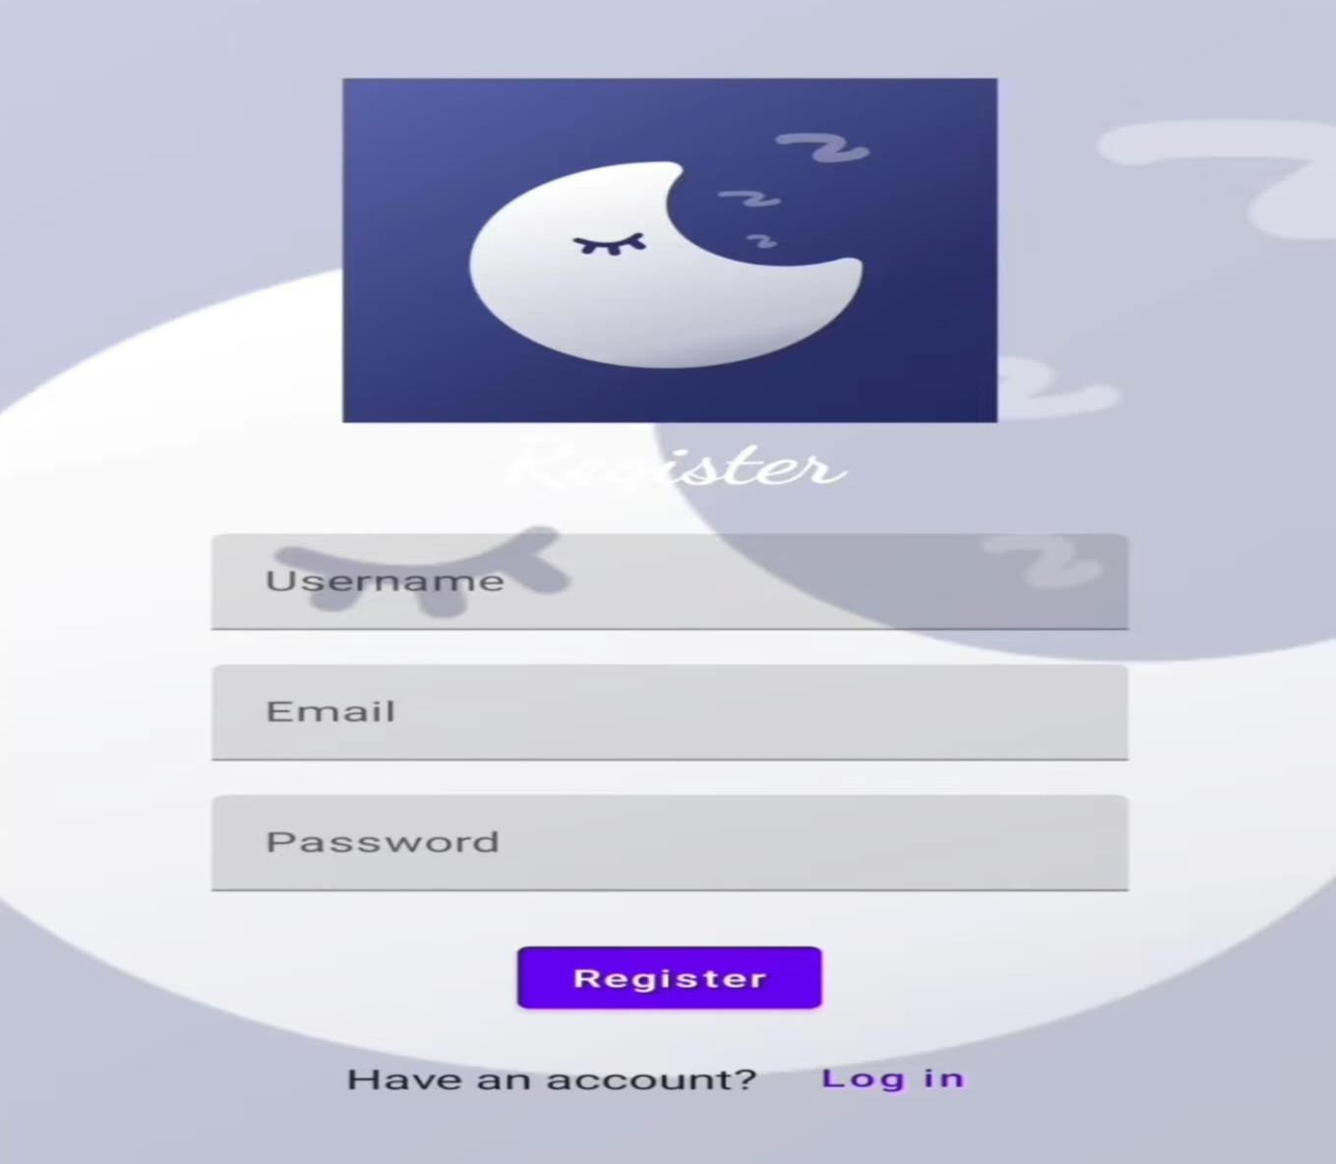

Slide 17
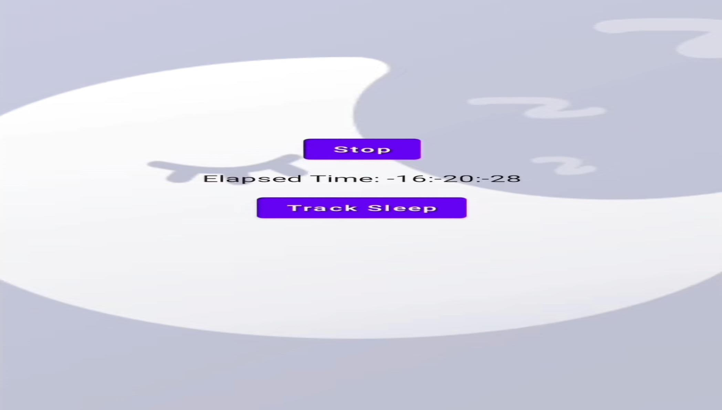

Slide 18
